Slide 1
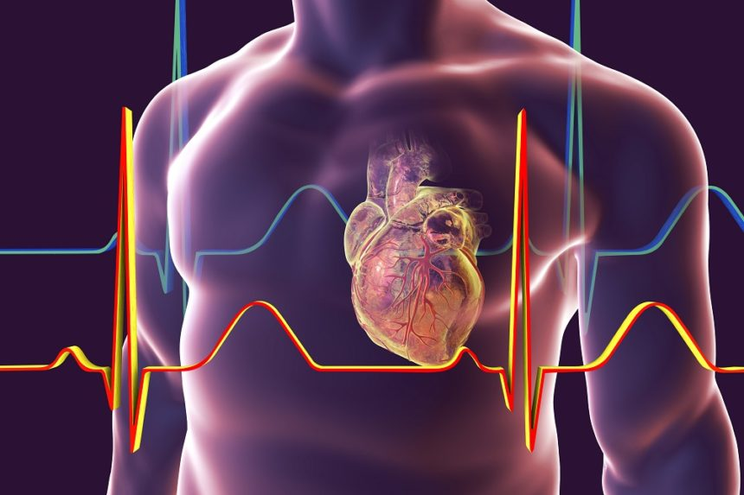
Acute Coronary Syndrome
Lecture 1
critical care (4 Stage)
By
Assistant. Lecturer. Maher Abdulameer
Fundamentals of Nursing Department
College of Nursing
University of Basra

Slide 2
OUTLINE
Coronary artery disease
Acute coronary syndrome
Risk factor
Pathophysiology
Clinical presentation
Diagnosis
Management
Nursing diagnosis
Lifestyle and remedies home

Slide 3
Coronary artery disease(CAD)
A narrowing of the coronary arteries that prevents adequate blood supply to the heart muscle is called coronary artery disease.
coronary artery disease is also known as:
1. atherosclerotic heart disease
2. coronary atherosclerosis
3. coronary arteriosclerosis
4. coronary heart disease

Slide 4
Acute coronary syndrome(ACS)
is a term used to define potential complications of CAD.
This syndrome includes:
Unstable angina
ST Elevation Myocardial Infarction: (STEMI)
Non ST Elevation Myocardial Infarction: (NSTEMI)

Slide 7
Pathophysiology
Acute coronary syndrome usually results from the buildup of fatty deposits (plaques) in and on the walls of coronary arteries, the blood vessels delivering oxygen and nutrients to heart muscles.
When a plaque deposit ruptures or splits, a blood clot forms.
This clot blocks the flow of blood to heart muscles.
When the supply of oxygen to cells is too low, cells of the heart muscles can die.
The death of cells — resulting in damage to muscle tissues — is a heart attack (myocardial infarction).

Slide 8
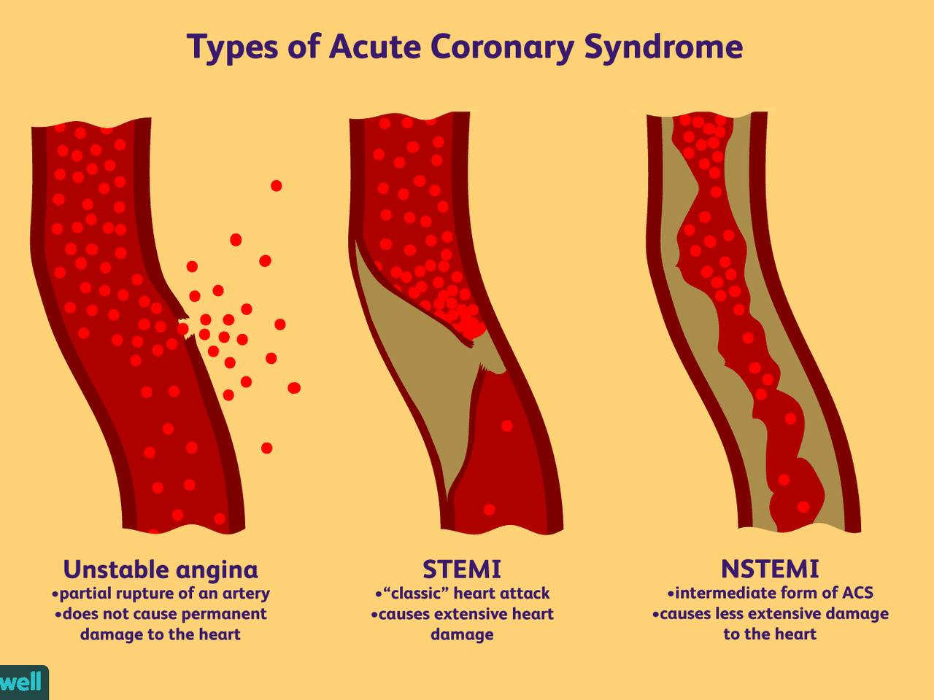

Slide 10
Risk factors
Modifiable
High blood pressure
High blood cholesterol
Cigarette smoking
Lack of physical activity
Unhealthy diet
Obesity or overweight
Diabetes
COVID-19 infection

Slide 11
Non modifiable
Family history of chest pain, heart disease or stroke
increasing age
Gender(male)
Race

Slide 12
Signs & symptoms
Chest pain (angina) or discomfort, often described as aching, pressure, tightness or burning
Pain spreading from the chest to the shoulders, arms, upper abdomen, back, neck or jaw
Nausea or vomiting
Indigestion
Shortness of breath (dyspnea)
Sudden, heavy sweating (diaphoresis)
Lightheadedness, dizziness
Unusual or unexplained fatigue

Slide 13
Unstable Angina
Unstable angina is the sudden onset of chest pain, pressure, or tightness resulting from insufficient blood flow through coronary arteries.

Slide 14
Pathophysiology
Atherosclerosis → obstruction of coronary arteries → decrease blood flow through coronary arteries → decrease oxygen supply to myocardial demand for O2 during exertion or emotional stress → angina.

Slide 15
Clinical Presentation
Chest pain manifests as follows: sub sternal pain, tightness, dullness, fullness, heaviness, or pressure
Dyspnea
Syncope
pain radiating to arms, epigastrium, shoulder, neck, or jaw.

Slide 16
Acute Myocardial Infarction (AMI)
AMI is the acute death of myocardial cells resulting from lack of oxygenated blood flow in the coronary arteries.
It is also known as a heart attack.

Slide 17
pathophysiology
Injury to the artery’s endothelium → increases platelet adhesion → inflammatory response causing monocytes and T lymphocytes to migrate in the intima →rupture triggers thrombus formation and vasoconstriction → result: thrombus with narrowing artery.
If occlusion lasts more than 20 min, can lead to AMI.

Slide 18
Clinical manifestation
AMI manifests with chest pain or discomfort lasting 20 min or longer. Pain can be described as pressure, tightness, heaviness, burning, or a squeezing or crushing sensation, located typically in the central chest or epigastrium; it may radiate to the arms, shoulders, neck, jaw, or back.
Discomfort may be accompanied by weakness, dyspnea, diaphoresis, or anxiety; not relieved by NTG.

Slide 19
Diagnosis
•History collection
•Physical examination
•Cardiac enzymes( cardiac biomarkers)
•Electrocardiograms
•Echocardiograms
•Stress Tests
•Angiography

Slide 20
Cardiac biomarkers
enzymes | hours | days
CK MB | 4-6 | 2-4
TROPONIN IT | 4-6 | 7-10
MYOGLOBIN | 2-4 | 2-4
LDH | 12-24 | 7-12
AST | 6-8 | 4-6
enzyme
hours
days

Slide 21
Electrocardiograms (ECGS or EKGS)
Provide a record of the heart's electrical activity.
Echocardiograms
It is may be ordered if doctor suspects a problem with the heart muscle or one of the valves that channel blood through the heart.

Slide 22
Normal ECG

Slide 23
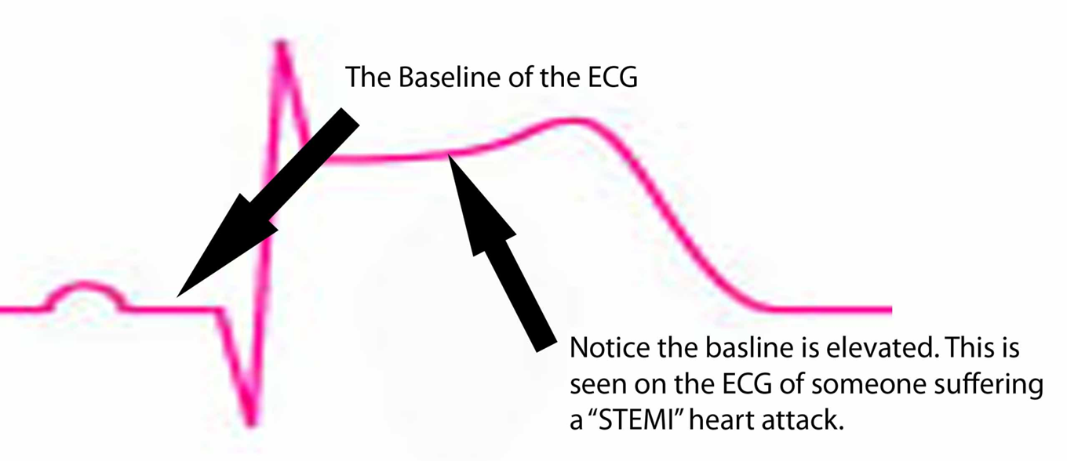

Slide 24
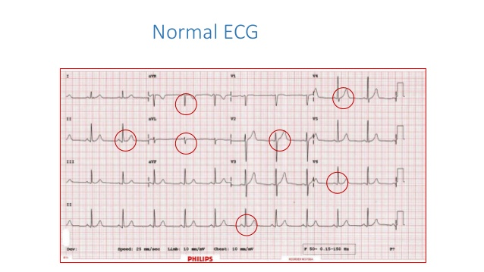
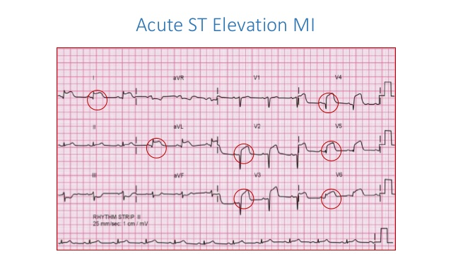

Slide 25
Stress tests
They are used to show how the heart reacts to physical exertion. Exercise stress tests are usually performed on a treadmill or exercise bicycle.
Angiography
•Is the most accurate means by which to examine the coronary arteries
• It requires a surgical procedure called cardiac catheterization.

Slide 26
TREATMENT IN ER
ABC
2 IV LINE CANNULA
Oxygen if decrease oxygen
4 tablet asprin 75 and 4 table clopidogrel 75 chwable
If sever pain------ morphine and metoclopramide iv
Nitrate( sublingual)
ECG and cardiac enzyme( troponine – CKmB)

Slide 27
Management
Medications
Thrombolytics (clot busters) help dissolve a blood clot that's blocking an artery.
Nitroglycerin improves blood flow by temporarily widening blood vessels.
Antiplatelet drugs help prevent blood clots from forming and include aspirin, clopidogrel (Plavix), and others.
Beta blockers help relax heart muscle and slow heart rate. They decrease the demand on heart and lower blood pressure.
Examples include metoprolol (Lopressor) and nadolol (Corgard).

Slide 28
Angiotensin-converting enzyme (ACE) inhibitors widen blood vessels and improve blood flow, allowing the heart to work better.
They include lisinopril ( Zestril), and others.
Angiotensin receptor blockers (ARBs) help control blood pressure and include irbesartan (Avapro), losartan (Cozaar) and several others.
Statins lower the amount of cholesterol moving in the blood and may stabilize plaque deposits, making them less likely to rupture.
Statins include atorvastatin (Lipitor), simvastatin (Zocor) and several others.

Slide 29
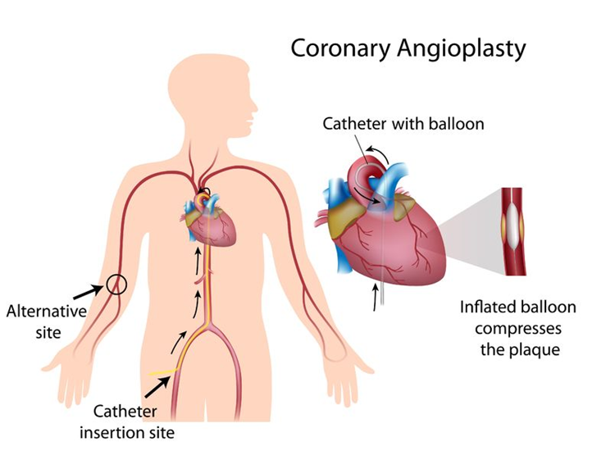
Surgery and other procedures
Angioplasty and stenting: In this procedure, inserts a long, tiny tube (catheter) into the blocked or narrowed part of artery.

Slide 30
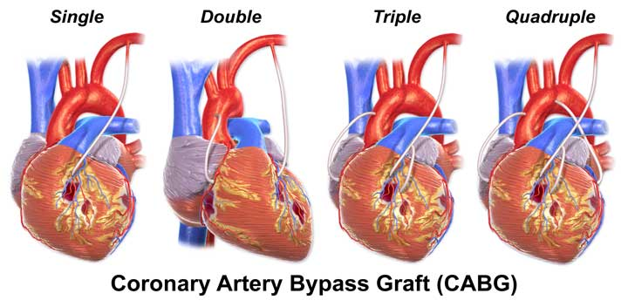
Coronary bypass surgery: With this procedure, a surgeon takes a piece of blood vessel (graft) from another part of body and creates a new route for blood that goes around (bypasses) a blocked coronary artery.

Slide 31
Complications
♣ Chest pain (angina)
♣ Heart attack( MI)
♣ Heart failure
♣ Abnormal heart rhythm (arrhythmia).

Slide 32
Nursing mangement
ASSESSMENT
Gather information about patient symptoms and activities.
Assess patients risk factors for CAD
Assess patients family understanding about diagnosis
Identify patients and family level of anxiety and use of appropriate coping mechanisms

Slide 33
obtain and assess ECG
Check vital sigs and report of LDL level
Evaluate patients medical history for such conditions as diabetes, heart failure, previous MI, obstructive lung disease that may influence choice of drug therapy

Slide 34
Nursing Diagnosis
Acute pain related to imbalance to oxygen supply demand
Decreased cardiac output related to reduced preload afterload contractility and heart rate secondary to hemodynamic effects of drug therapy
Anxiety related to chest pain, uncertain prognosis, and threatening environment

Slide 35
Nursing intervention
Administer oxygen to maintain SaO2 >93%.
Establish IV access.
Perform continuous cardiac monitoring.
Administer SL(sub lingual) nitroglycerin tablets or oral spray, every 5 min × 3 doses. If pain persists, IV nitroglycerin may be started.

Slide 36
Monitor for hypotension and headaches from vasodilatation.
Administer non-enteric coated aspirin (162–325 mg).
Administer IV morphine, 4–8 mg initially with increments of 2–8 mg repeated at 5–15 min intervals until pain is controlled. Use lower dose in elderly patients.
Monitor for hypotension and respiratory depression.
Administer clopidogrel 300–600 mg loading dose (600 mg preferred dose).

Slide 37
Lifestyle and home remedies
Don't smoke. If smoke, quit.. Also, avoid secondhand smoke.
Eat a heart-healthy diet. Eat a diet with lots of fruits and vegetables, whole grains, and moderate amounts of low-fat dairy and lean meats.
Be active. Get regular exercise and stay physically active.
Check cholesterol. Avoid high-fat, high-cholesterol meat and dairy.
Control blood pressure. Take blood pressure daily as recommended.
Maintain a healthy weight. Excess weight strains heart and can contribute to high cholesterol, high blood pressure, diabetes, heart disease and other conditions.
Manage stress. To reduce risk of a heart attack, reduce stress in day-to-day activities.

Slide 39
HOME WORK
What Is Difference Between Stable Angina And Unstable Angina?

